Slide 1
Improving Search Result Summaries by Using Searcher Behavior Data
Date: 2013/9/25
Author: Mikhail Ageev, Dmitry Lagun,
Eugene Agichtein
Source: SIGIR’13
Advisor: Jia-ling Koh
Speaker: Chen-Yu Huang

Slide 2
Outline
Introduction
Behavior-biased snippet generation
Text-based snippet generation
Inferring relevant text fragment from search behavior
Experiment
Data collection and experiment setup
result
Conclusion

Slide 3
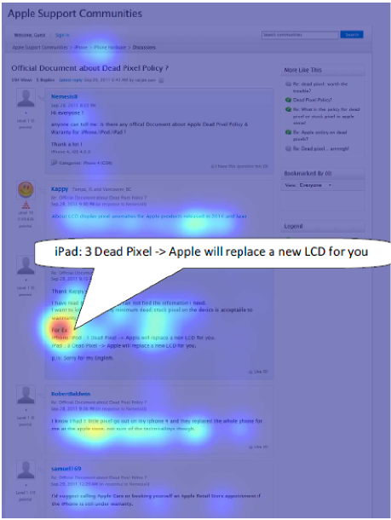
Introduction
Improve snippet generation for informational queries
Include the desired information directly
Provide sufficient information for the user to distinguish
An ideal snippet would include the text fragment where user focused his attention

Slide 4
Introduction
Following the literature on snippet quality, snippets must satisfy:
Representativeness
Readability
Judgeability
Not to replace the existing text-based snippet generation approaches, but rather to add additional evidence.
Present a new approach to improving result summaries by incorporating post-click searchers behavior data.

Slide 5
Outline
Introduction
Behavior-biased snippet generation
Text-based snippet generation
Inferring relevant text fragment from search behavior
Experiment
Data collection and experiment setup
result
Conclusion

Slide 6
Behavior-biased snippet generation
Generate candidate fragments (use a strong text-only baseline)
Infer the document fragments of interest to the user (based on user examination data)
Generate the final behavior-biased snippet (BeBS)

Slide 7
Behavior-biased snippet generation
Make three key assumption:
Primarily target informational queries
Assume that document visits can be grouped by query intent
Assume that user interactions on landing pages can be collected by a search engine or a third party

Slide 8
Text-biased snippet generation
For a given query we first select all the sentences that have at least one match of query terms.
Extend the method of Metzler and Kanungo by adding additional features.
Train a Gradient Boosting Regression Tree model(GBRT) on a subset of training query-URL pairs to predict snippet fragment scores.

Slide 9
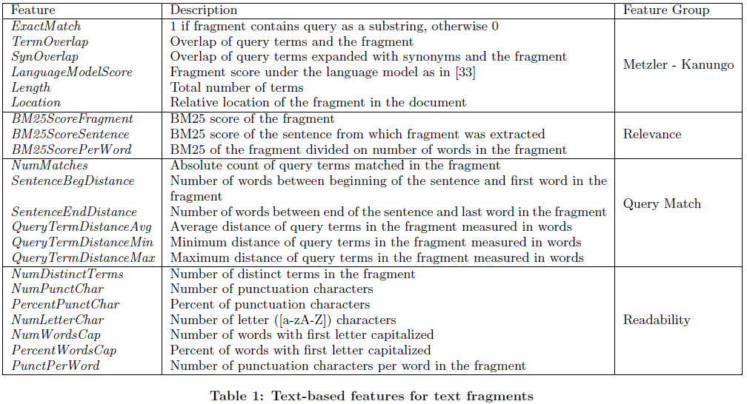
Text-biased snippet generation

Slide 10
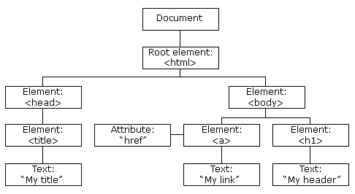
Inferring relevant text fragments from search behavior
Collect searcher interactions on web pages
Adapt the publicly available EMU toolbar for Firefox browser , that is able to collect mouse cursor movement.
After the html page is rendered in the browser, modifies the document DOM tree, so that each word is wrapped by a separate DOM element tags.

Slide 11
Behavior-biased snippet generation
For each page visit we know
the searcher’s intent
the search engine query that user issued
the URL
the contents of the document
the bounding boxes of each word in HTML text
the log of behavior actions
( mouse cursor coordinates , mouse clicks, scrolling,
an answer to the question that the user found )

Slide 12
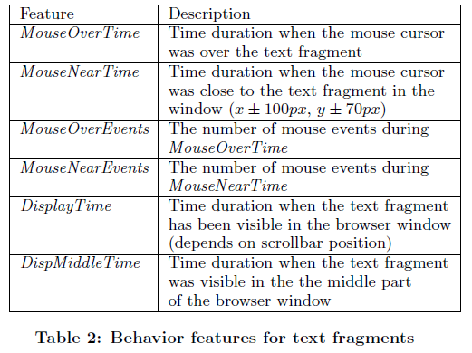
Inferring relevant text fragments from search behavior
Focus on capturing user’s behavior associated with focused attention, not contain any document or query information.

Slide 13
Inferring relevant text fragments from search behavior
Train the GBRT model on the training set of the labeled document fragments.
Training set (stemming and stopword removal)
label | The answer that user submitted is correct
The answer shares words with the fragment | 1
The answer shares no word the fragment | 0

Slide 14
Behavior-biased snippet generation system
Combine the text-based score TextScore(f) for candidate fragment with the behavior-based score BScore(f), infer from the examination data.
TextScore(f) value in the range[1,5]
Bscore(f) value in the range[0,1]

Slide 15
Outline
Introduction
Behavior-biased snippet generation
Text-based snippet generation
Inferring relevant text fragment from search behavior
Experiment
Data collection and experiment setup
result
Conclusion

Slide 16
Data collection and experimental setup
The participants were recruited through the Amazon Mechanical Turk.
The participants played a search contest “game” consisting of 12 search questions to solve.
98 users
1175 search sessions
2289 page visits
508 distinct URLs
707 different query-URL pairs

Slide 17
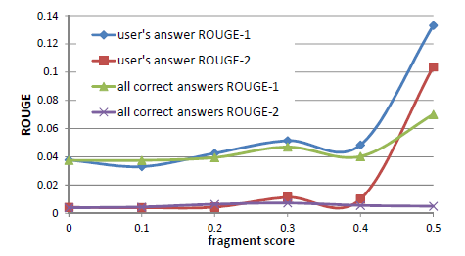
Result
Prediction of fragment interestingness
10-fold cross validation(disjoint)
ROUGE

Slide 18
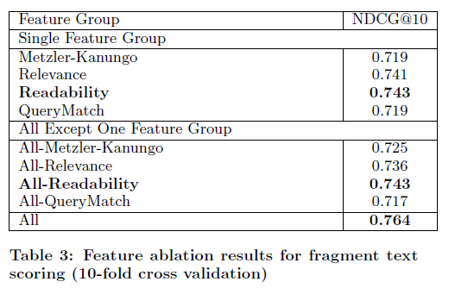
Result
Text-based baseline

Slide 19
Result
BeBS system
λ affects two characteristics of the algorithm:
Snippet coverage: the ratio of the snippets produced by the behavior-
biased algorithm
Snippet quality: judgeability, readability, representativeness, via manual
assessments

Slide 20
Result
BeBS system

Slide 21
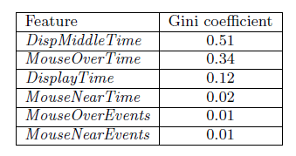
Result
Behavior feature
Notes:
Difficult query

Slide 22
Outline
Introduction
Behavior-biased snippet generation
Text-based snippet generation
Inferring relevant text fragment from search behavior
Experiment
Data collection and experiment setup
result
Conclusion

Slide 23
Conclusion
Presented a novel way to generate behavior-biased search snippets.
Method was primarily targeted informational queries, an important consideration is how to generalize approach to a wider class of queries.
Approach is not necessarily limited to desktop-based computers with a mouse.

